Slide 1
Microbiology: why should we care?

Slide 2
There are 10 times more bacteria in your digestive system than there are cells in your entire body.

Slide 3
There are more microbes on your hand than there are people on the planet

Slide 4
Microbes generate at least half the oxygen we breathe

Slide 5
If a single bacterium with a generation time of 20 min reproduced for 48 hr, the population it produced would weigh about 4000 times the weight of the Earth

Slide 6
Microbes are significant.

Slide 8
Virus

Slide 9
Virus
Archaea

Slide 10
Virus
Archaea
Bacteria

Slide 11
Protists
Virus
Archaea
Bacteria

Slide 12
Protists
Virus
Archaea
Bacteria
Characteristics?

Slide 13
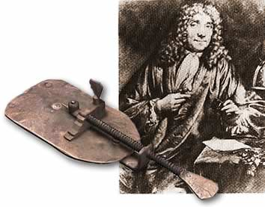
Microscopes
Probably invented early 1600’s
Popularized by Antonie van Leeuwenhoek
“Father of microscopy”
Discovered microorganisms 1676

Slide 16
Microscopes: light vs. electron

Slide 17
Microscopes: light vs. electron
Light microscopy (and Fluorescence microscopy)

Slide 18
Microscopes: light vs. electron
Light microscopy (and Fluorescence microscopy)
Can be used on living samples
Active processes
Observe in real time

Slide 19
Microscopes: light vs. electron
Light microscopy (and Fluorescence microscopy)
Can be used on living samples
Active processes
Observe in real time
Colour

Slide 20
Microscopes: light vs. electron
Light microscopy (and Fluorescence microscopy)
Can be used on living samples
Active processes
Observe in real time
Colour
Maximum magnification: 1000x

Slide 21
Microscopes: light vs. electron
Light microscopy (and Fluorescence microscopy)
Can be used on living samples
Active processes
Observe in real time
Colour
Maximum magnification: 1000x

Slide 22
Microscopes: light vs. electron
Electron microscope

Slide 23
Microscopes: light vs. electron
Electron microscope
2 million x magnification

Slide 24
Microscopes: light vs. electron
Electron microscope
2 million x magnification
Black and white

Slide 25
Microscopes: light vs. electron
Electron microscope
2 million x magnification
Black and white
Sample must be dead

Slide 26
Microscopes: light vs. electron
Electron microscope
2 million x magnification
Black and white
Sample must be dead
Two-types:
Transmission electron microscope (TEM)
Extremely thin section of specimen
2-D image

Slide 27
Microscopes: light vs. electron
Electron microscope
2 million x magnification
Black and white
Sample must be dead
Two-types:
Transmission electron microscope (TEM)
Extremely thing section of specimen
2-D image
Scanning electron microscope (SEM)
3-D surface image

Slide 28
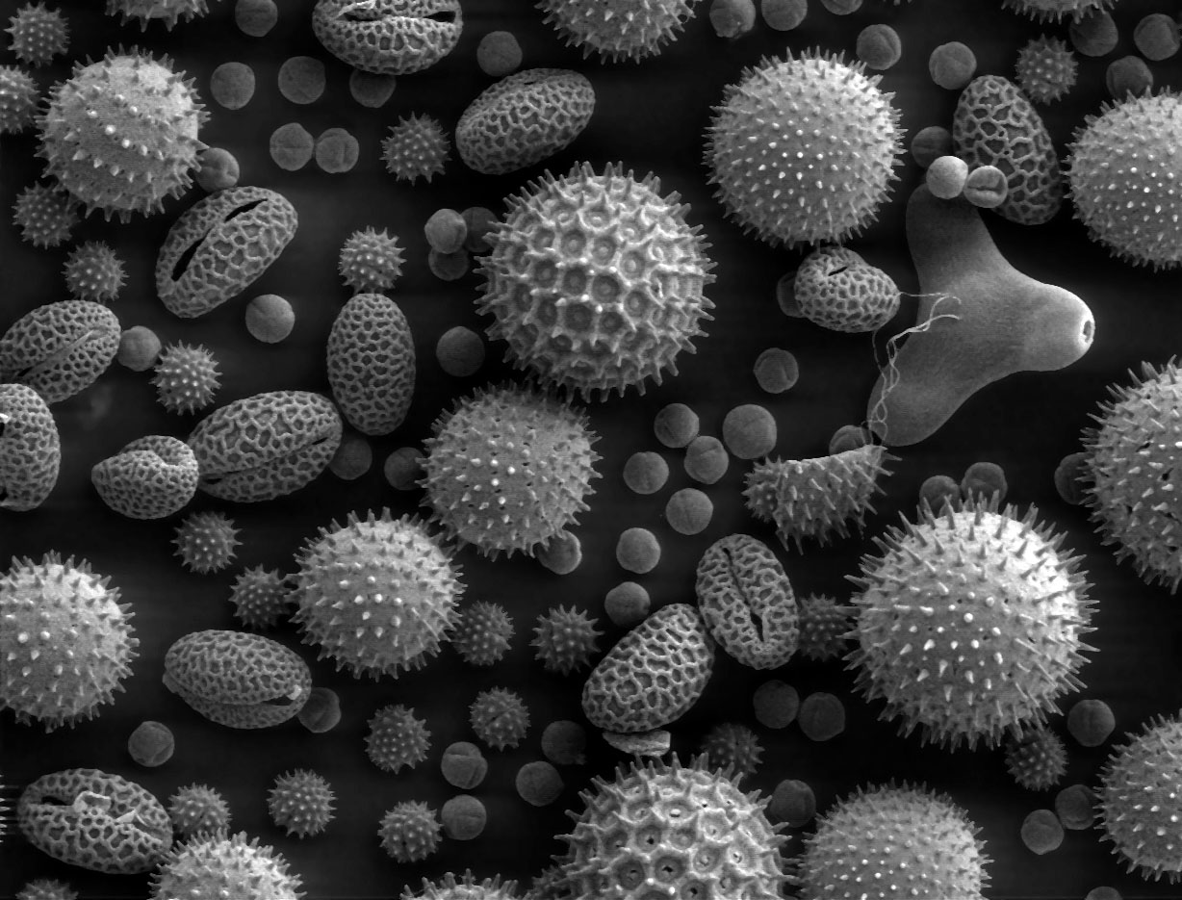
Microscopes: light vs. electron
Electron microscope
2 million x magnification
Black and white
Sample must be dead
Two-types:
Transmission electron microscope (TEM)
Extremely thing section of specimen
2-D image
Scanning electron microscope (SEM)
3-D surface image

Slide 29
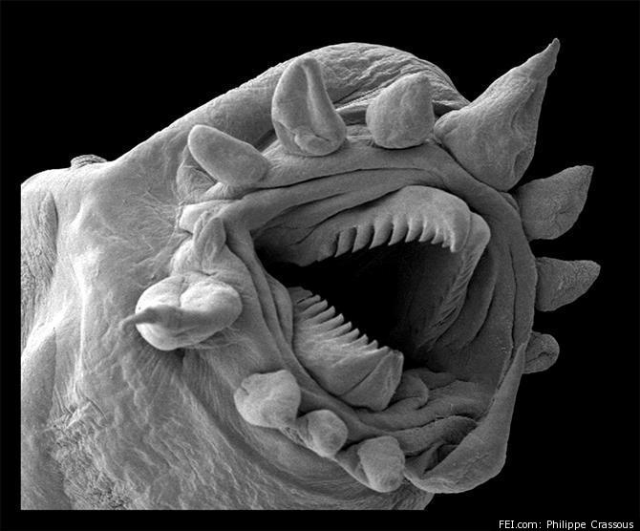
Microscopes: light vs. electron
Electron microscope
2 million x magnification
Black and white
Sample must be dead
Two-types:
Transmission electron microscope (TEM)
Extremely thing section of specimen
2-D image
Scanning electron microscope (SEM)
3-D surface image

Slide 30
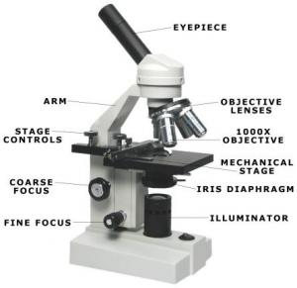
Important parts:

Slide 31
Calculations: magnification
$$Magnification= \frac{image size}{object size}$$
Useful for comparing a drawing/image with the actual size of an object

Slide 32
Calculations: magnification
$$Magnification= \frac{image size}{object size}$$
Example: you measure this image and find that it is 3.2 cm long. This bacterium is actually 2.1$μm$. What is the magnification of this image?
3.2 cm

Slide 33
Calculations: object size
$$Actual size= \frac{Field of view}{\# of specimen that fit in the field}$$
Field of view = diameter of the circle you see through the microscope
40x = 4500 $μm$
100x = 1500 $μm$
400x = 450 $μm$
Useful when you know the magnification and you want to calculate the actual size of the specimen you are viewing

Slide 34
Calculations: object size
$$Actual size= \frac{Field of view}{\# of specimen that fit in the field}$$
Example: You view this image at 100x magnification.
You estimate that 4.5 cells could fit in
your field of view. What is the actual
size of this cell?

Slide 35
Microscope lab skills
Safe behaviour!
Carrying your microscope
Creating a slide
Focusing your microscope: 4x, 10x, 40x
Troubleshooting

